Slide 1
Chapter 2 Operating-System Structures

Slide 2
Outline
Operating System Services
User and Operating-System Interface
System Calls
System Services
Linkers and Loaders
Why Applications Are Operating-System Specific
Operating-System Design and Implementation
Operating-System Structure
Building and Booting an Operating System
Operating System Debugging

Slide 3
Outline
Operating System Services
User and Operating-System Interface
System Calls
System Services
Linkers and Loaders
Why Applications Are Operating-System Specific
Operating-System Design and Implementation
Operating-System Structure
Building and Booting an Operating System
Operating System Debugging

Slide 4
Operating System Services
OS provides services to programs and users
E.g.,
Program execution
Manage hardware
……

Slide 5
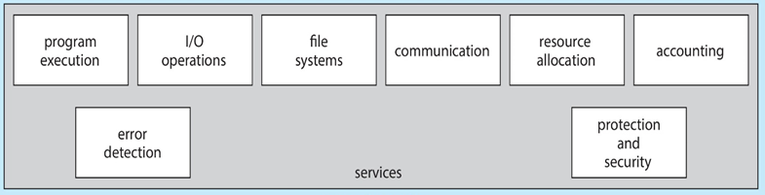
Program 1
Program 2
User Mode
Kernel Mode
OS
hardware 1
hardware 2
hardware 3

Slide 6
Outline
Operating System Services
Operating-System Interface to Users
System Calls
System Services
Linkers and Loaders
Why Applications Are Operating-System Specific
Operating-System Design and Implementation
Operating-System Structure
Building and Booting an Operating System
Operating System Debugging

Slide 7
User Operating System Interface
For users, fundamental approaches to interface with the OS (see the following slide)
Command-line interface (CLI) (or command interpreter)
Batch interface
Graphical User Interface (GUI)
Touch-Screen Interface

Slide 8
User Operating System Interface
For users, fundamental approaches to interface with the OS (see the following slide)
Command-line interface (CLI) (or command interpreter)
Batch interface
Graphical User Interface (GUI)
Touch-Screen Interface

Slide 9
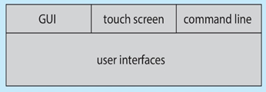
user 1
user 2
User Mode
Kernel Mode
OS
hardware 1
hardware 2
hardware 3

Slide 10
User Operating System Interface : CLI
Command interpreter (CLI) allows directly typing commands
Fetch a command from user and execute
Implemented as a system program
Not part of OS
In Linux, multiple choices are implemented – shells
Bourne shell (bash), C shell (csh), Korn shell (ksh)

Slide 11
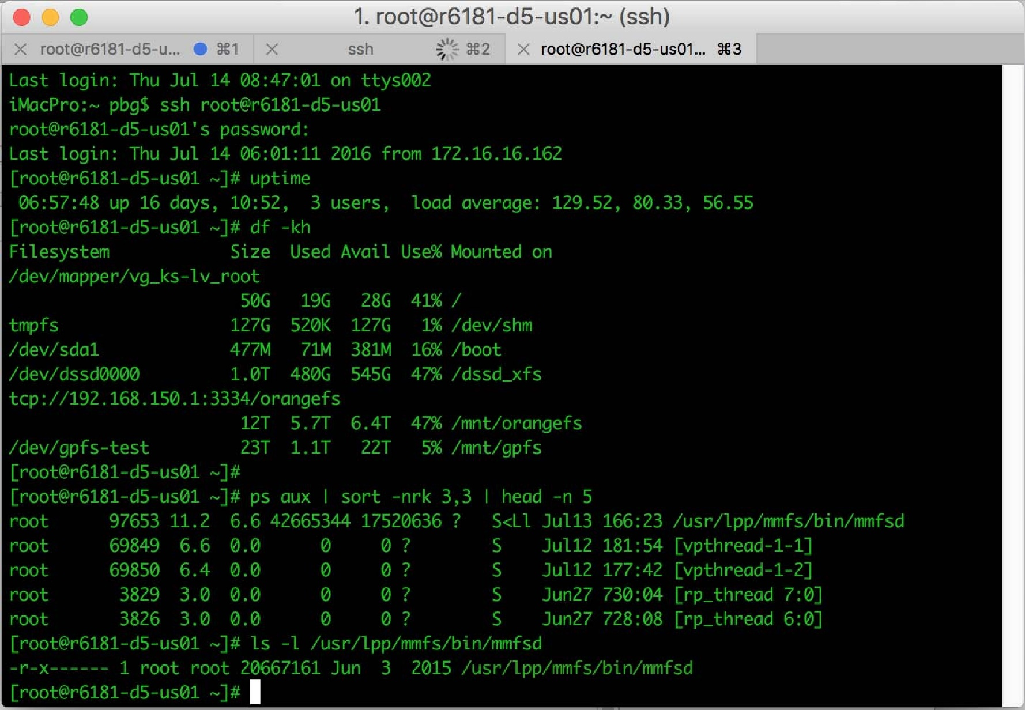
Shell Command Interpreter

Slide 12
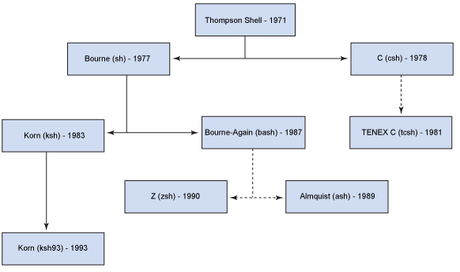
User
Shell
OS
hardware

Slide 13
User Operating System Interface
For users, fundamental approaches to interface with the OS (see the following slide)
Command-line interface (CLI) (or command interpreter)
Batch interface
Graphical User Interface (GUI)
Touch-Screen Interface

Slide 14
User Operating System Interface : Batch Interfaces
cc -g -c menu.c
cc -g -o driver driver.c menu.o
driver < test_data > test_out
lpr -PthePrinter test_out
tar cvf driver_test.tar menu.c driver.c test_data test_out
uuencode driver_test.tar driver_test.tar >driver_test.encode
A “shell script” batch File
from “Operating Systems by NUTT”

Slide 15
User Operating System Interface
For users, fundamental approaches to interface with the OS (see the following slide)
Command-line interface (CLI) (or command interpreter)
Batch interface
Graphical User Interface (GUI)
Touch-Screen Interface

Slide 16
User Operating System Interface : GUI
User-friendly desktop interface
Mouse-based window-and-menu

Slide 17
User Operating System Interface
For users, fundamental approaches to interface with the OS (see the following slide)
Command-line interface (CLI) (or command interpreter)
Batch interface
Graphical User Interface (GUI)
Touch-Screen Interface

Slide 18
User Operating System Interface : Touchscreen Interfaces
Touchscreen devices
Voice commands

Slide 19
Outline
Operating System Services
Operating-System Interface to Users
System Calls
System Services
Linkers and Loaders
Why Applications Are Operating-System Specific
Operating-System Design and Implementation
Operating-System Structure
Building and Booting an Operating System
Operating System Debugging

Slide 20
Before discussing system call, 我們先複習Library

Slide 21
補充: Example of Programs Using Libraries in Linux
int add(int arg) {
arg++;
return arg;
}
int sub(int arg) {
arg--;
return arg;
}
int abc() {
…
}
a.c
int sum(int arg1, int arg2)
{
return (arg1+arg2);
}
int xyz()
{
……
}
b.c

Slide 22
補充: Example of Programs Using Libraries in Linux (Cont.)
libtmp.a
a.c
Compiler
a.o
a.o
link utility
Compiler
b.o
b.c
b.o
Creating a library called libtmp.a

Slide 23
補充: Example of Programs Using Libraries in Linux (Cont.)
#include <stdio.h>
extern int add(int);
extern int sub(int);
extern int sum(int, int);
main()
{
int ret1, ret2, ret3;
ret1 = add(5);
ret2 = sub(5);
ret3 = sum(ret1, ret2);
printf("\n ret from add()= %d", ret1);
printf("\n ret from sub()= %d", ret2);
printf("\n ret from sum()= %d", ret3);
}
int add(int arg) {
arg++;
return arg;
}
int sub(int arg) {
arg--;
return arg;
}
int abc() {
…
}
a.c
main.c
int sum(int arg1, int arg2)
{
return (arg1+arg2);
}
int xyz()
{
……
}
b.c

Slide 24
補充: Example of Programs Using Libraries in Linux (Cont.)
Object file
executable file
Source file
main.c
Compiler
main.o
main.o
linker
libtmp.a
libtmp.a
a.o
a.o
b.o
b.o
Link with libtmp.a to create the executable file

Slide 25
複習：Linker主要的工作是resolve external references (組合語言與系統程式)

Slide 26
補充: Example of Programs Using Libraries in Linux (Cont.)
Compile source programs to object programs
gcc –c main.c
gcc –c a.c
gcc –c b.c
Create/add/replace object programs into library
ar –r libtmp.a a.o b.o
List contents of library
ar –t libtmp.a
Delete object programs from library
ar –d libtmp.a b.o

Slide 27
補充: Example of Programs Using Libraries in Linux (Cont.)
Compile source programs to object programs
gcc –c main.c
Using library in programs
Ex. gcc main.o libtmp.a –o prog
Ex. gcc main.o –L. –ltmp –o prog
Linking editor
ld under SunOS
References
man gcc under SunOS
man ar under SunOS
man ld under SunOS

Slide 28
We also have an OS Lab discussing how to create a library.

Slide 29
複習結束

Slide 30
System Calls
System calls
Functions provided by OS to provide service to user applications
Example: open(), read(), write(), close()……
Even simple program (see the following example) may make heavy use of the system calls

Slide 31
Example
#include<stdio.h> #include<sys/types.h> #include<sys/stat.h>
#include<fcntl.h> #include<unistd.h>
#include<stdlib.h> //for exit()
#include <string.h> //for strlen()
int main(){
int fd;
fd = open("myfile.txt", O_CREAT | O_WRONLY, 0600);
if (fd < 0){
printf("Failed to open the fild.\n");exit(1); }
int size;
size = write(fd, "e", strlen("e") );
close(fd);
printf("length of write data=%d \n", strlen("e"));
printf("Number of bytes written on success=%d \n\n", size);
exit(0);
}

Slide 32
按照程式執行的規則，當呼叫open()時，程式應該會跳到對應的open() function。
這個例子：open()就是一個system call
問題：open() function在哪裡？

Slide 33
Program 1
open()…
Program 2
read()…
User Mode
open(), read()
Kernel Mode
open()
{
….
}
read() OS
{
…
}
Storage

Slide 34
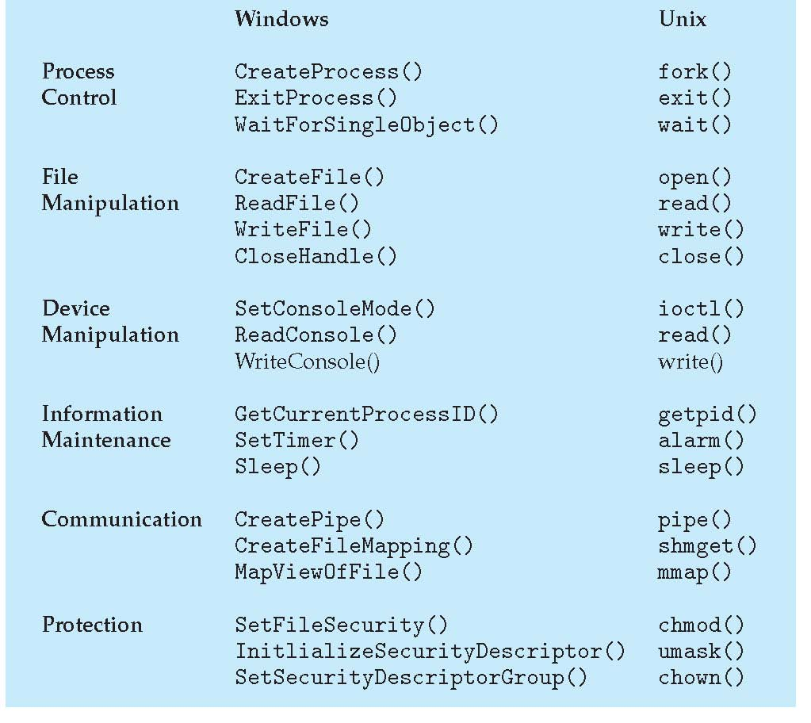
Examples of Windows and Unix System Calls
問題：為什麼system call介面不一樣?

Slide 35
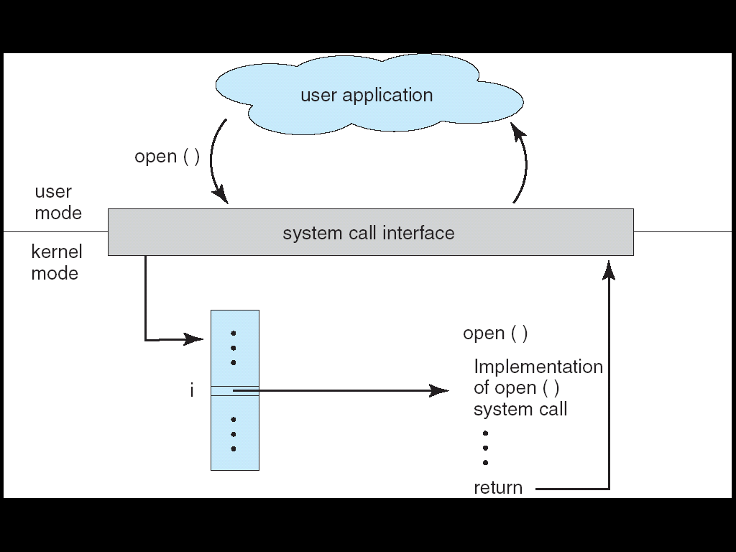
System Calls (Cont.)
Typically, a number is associated with each system call
OS maintain a table indexed according to these numbers

Slide 36
System Calls (Cont.)
…
int 0x10; // read();
…
CPU
…..
mode = 0;
mode = 1;
trap
OS

Slide 37
APIs
However, system calls are often accessed indirectly via a Application Program Interface (API)
Rather than directly calling the system call
fopen(), fread(), fwrite(), printf()….are APIs
See the following slide

Slide 38
Program 1
Program 2
fopen();
fopen() {
…
open();
…
}
C library
User Mode
Kernel Mode
open()
{
….
}
read() OS
{
…
}
Storage
C program invoking fopen () library call, which in turn calls open () system call

Slide 39
Example: Standard C Library
#include <stdio.h>
int main()
{
printf(“Greeting”);
…
}
Application
printf()
{
…
int 0x80;
…
}
C Library
(libc provides a wrapper of system calls.)
write()
{
…
…
}
OS
Hardware
Hardware
C program invoking printf() library call, which in turn calls write() system call

Slide 40
在上述的例子，fopen(), fread(), printf()……就是API

Slide 41
System Call and APIs
Application Program
Library API Function
(Ex:C Library, Windows Library)
OS Function
Hardware

Slide 42
Calling System Call and APIs: Example
#include<stdio.h> #include<sys/types.h> #include<sys/stat.h>
#include<fcntl.h> #include<unistd.h>
#include<stdlib.h> //for exit()
#include <string.h> //for strlen()
int main(){
int fd;
fd = open("myfile.txt", O_CREAT | O_WRONLY, 0600);
if (fd < 0){
printf("Failed to open the fild.\n");exit(1); }
int size;
size = write(fd, "e", strlen("e") );
close(fd);
printf("length of write data=%d \n", strlen("e"));
printf("Number of bytes written on success=%d \n\n", size);
exit(0);
}

Slide 43
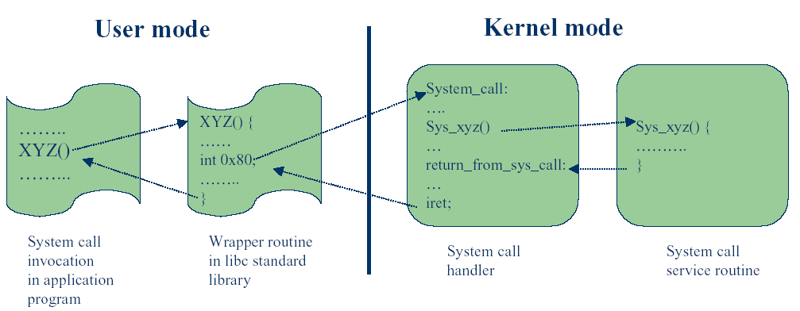
System Call and APIs

Slide 44
APIs (Cont.)
API: a set of functions that can be called by the programs
Three most common APIs
Win32 API for Windows
POSIX API for POSIX-based systems
All versions of UNIX, Linux, and Mac OS X
Java API for the Java virtual machine (JVM)
Supported by library
Kernel32.lib is the library of Win32 API (see the following slide)

Slide 45
複習：組合語言(Linking to a Library)
The two LIB files: irvine32.lib, and kernel32.lib
The irvine32.lib is provided by book’s author
The kernel32.lib is part of the Microsoft Win32 Software Development Kit (SDK)

Slide 46
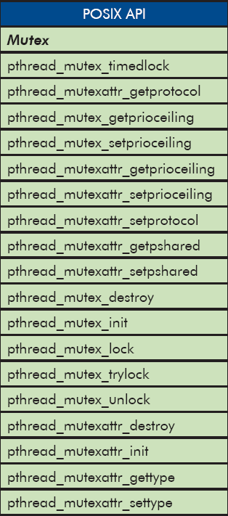
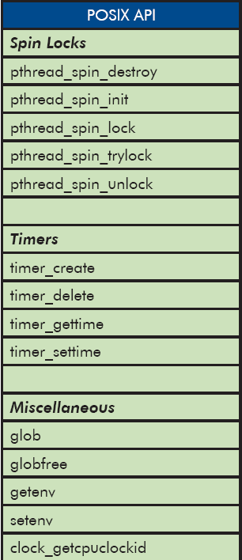
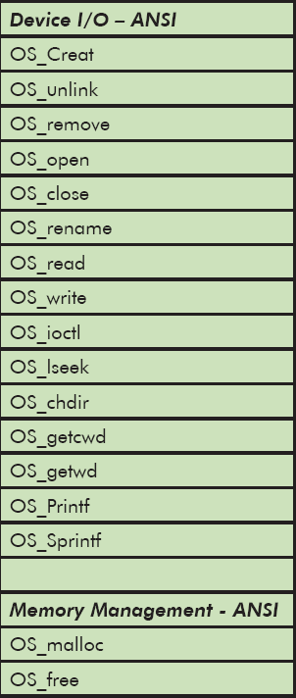
Some of POSIX APIs

Slide 47
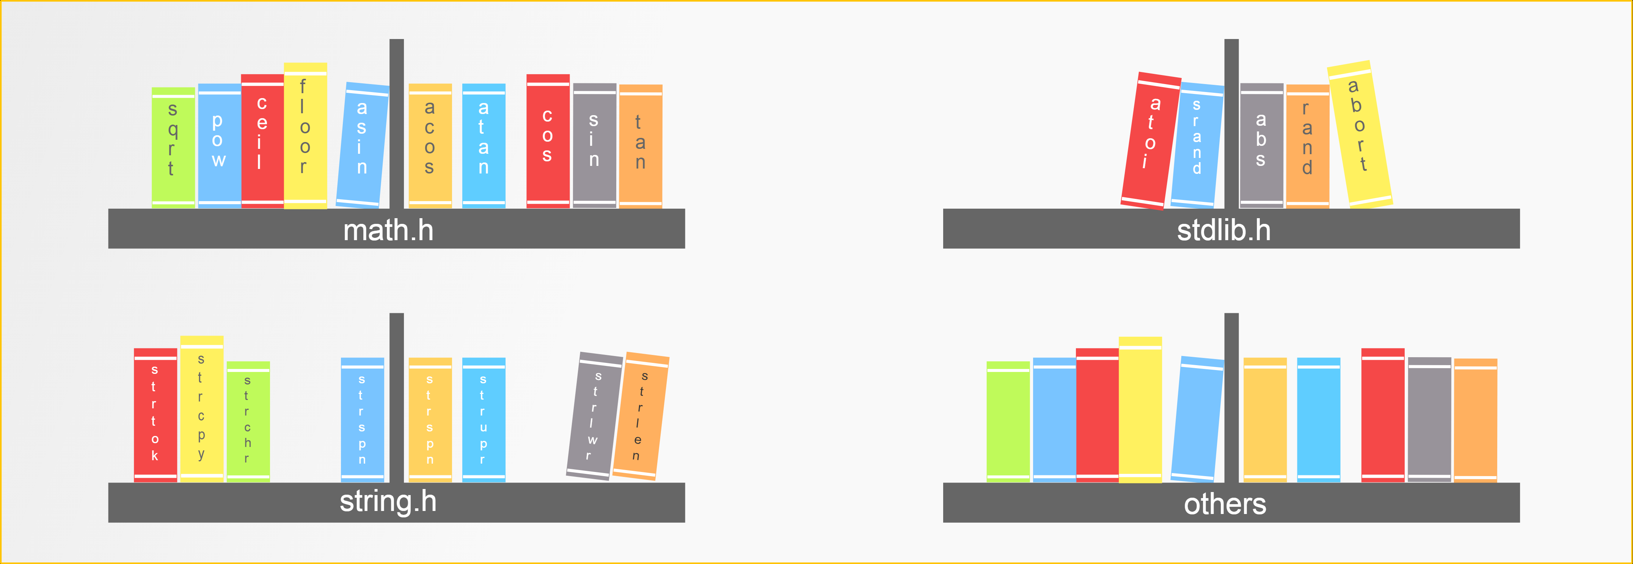
Example: Standard C Library

Slide 48
APIs (Cont.)
Why use APIs rather than system calls?
Portability
Application using APIs can be compiled and run on another platform using the same API
See the following three slides
Easier to use
System calls often be more detailed and difficult to use than APIs
E.g., printf() function provides output formatting, whereas the write() system call just outputs a block of bytes
Programmer knows nothing about how the system call is implemented
Details of system calls are hidden by APIs

Slide 49
Examples of Windows and Unix System Calls

Slide 50
Portability (Cont.)
…
CreateProcess()
…
…
fork()
…
Change to Linux
Need to modify
source code
Windows
Linux
CreateProcess()
fork()
since system call interface
is different

Slide 51
Portability
…
pthread_create()
…
…
pthread_create()
…
Change to VxWorks
Don’t need to modify
source code
POSIX Library
POSIX Library
Linux
VxWorks
fork()
new_thread()
even system call interface
is different

Slide 52
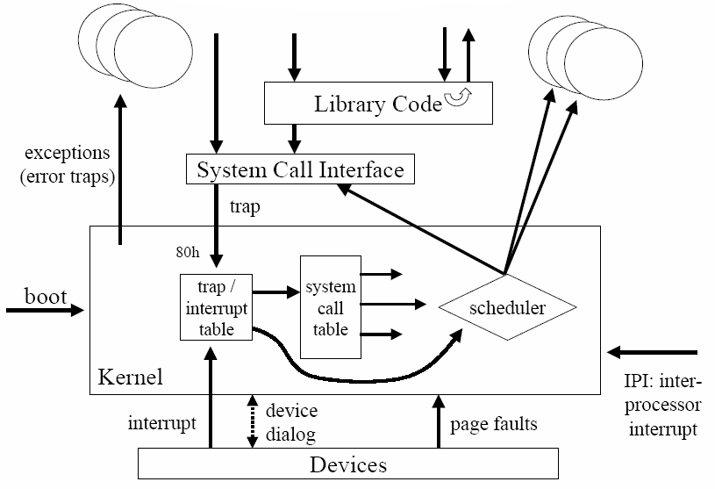
Summary

Slide 53
問題：當呼叫系統呼叫(system call)時，如何傳遞參數？
如下圖：應用程式如何傳遞參數給作業系統?

Slide 54
…
SYS_XYZ(…);
…
CPU
…..
OS
SYS_XYZ()
{
…
}

Slide 55
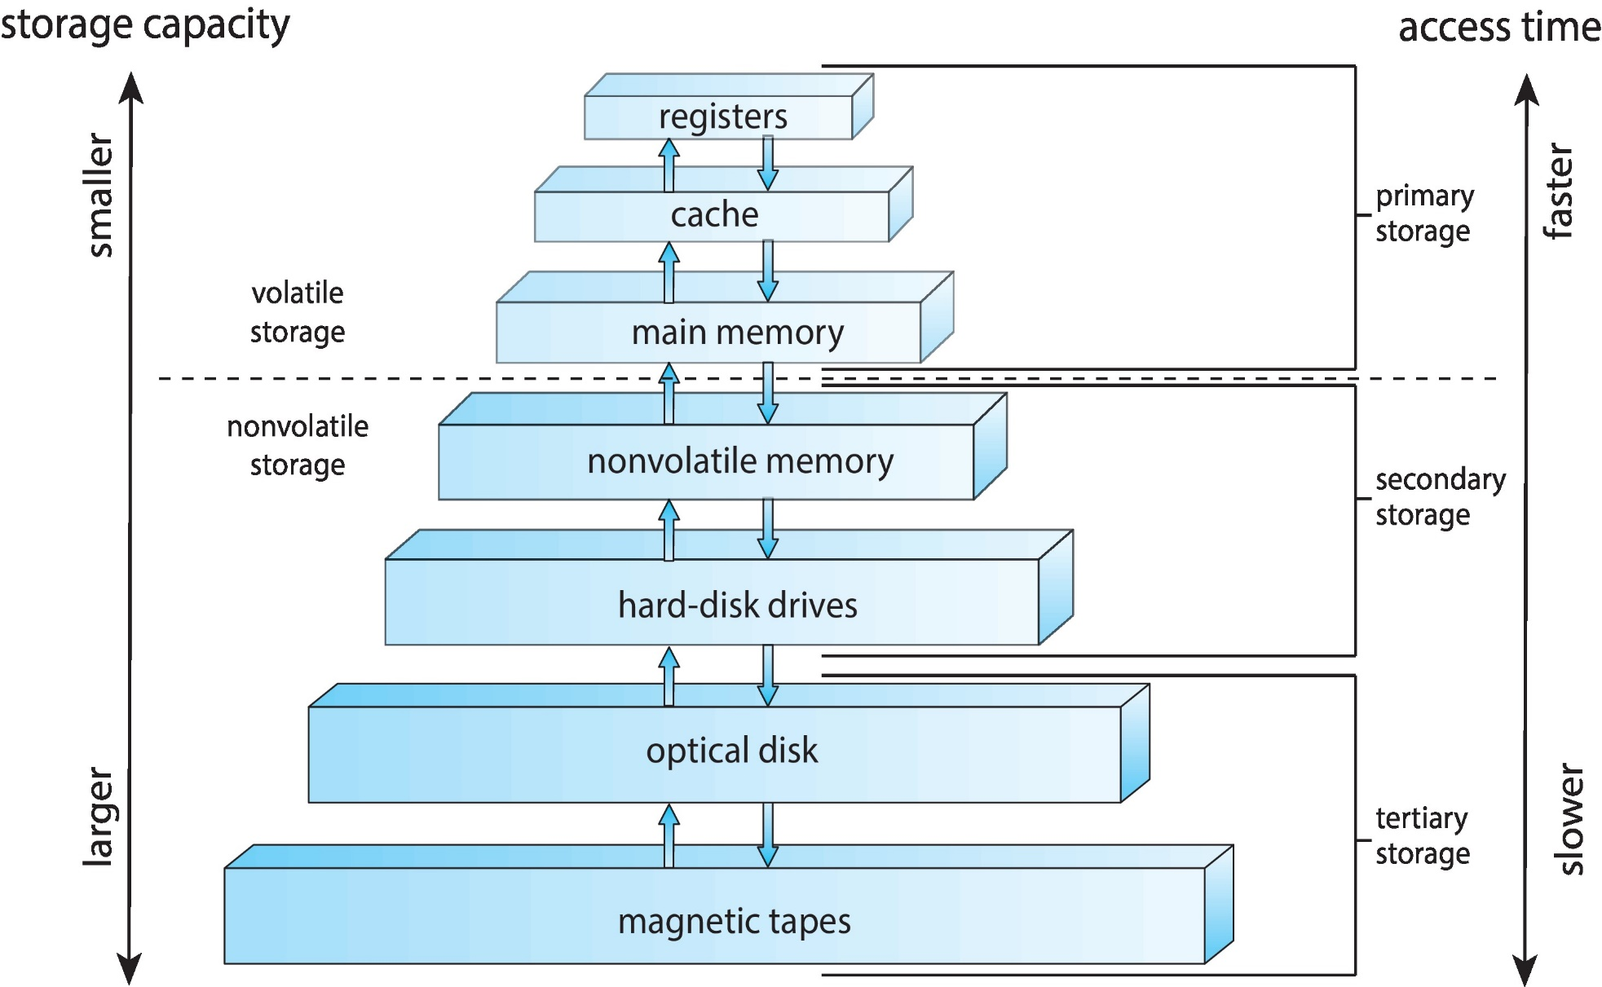
Idea: Storage Hierarchy

Slide 56
System Call Parameter Passing
Three methods used to pass parameters to the OS
Pass the parameters in registers
In some cases, may be more parameters than registers
Parameters stored in a block in memory, and address of block passed as a parameter in a register
Taken by Linux and Solaris
Parameters pushed onto the stack by the program and popped off the stack by the OS
Block and stack methods do not limit the number or length of parameters

Slide 57
Passing Parameters to System Calls: CPU Registers
mov eax, 10
mov ebx, 20
int SYS_XYZ;
……
User Mode
system_call
Kernel Mode
SYS_XYZ :
mov a, eax; a = 10;
mov b, ebx; b = 20;
……

Slide 58
Passing Parameters to System Calls: CPU Registers
…
mov eax, 10
mov ebx, 20
int 0x10; //SYS_XYZ;
…
CPU
eax | 10
ebx | 20
…..
OS
SYS_XYZ()
{
…
}

Slide 59
Passing Parameters to System Calls: Memory Block
eax
0x1000
mov eax, 0x1000
int SYS_XYZ;
……
0x1000
greetings
User Mode
Kernel Mode
system_call
SYS_XYZ :
user parameters pointed by eax
……
memory

Slide 60
Passing Parameters to System Calls: Memory Block
…
move eax, 0x1000
int 0x10; //SYS_XYZ;
…
CPU
…..
eax | 0x1000
greetings
OS
SYS_XYZ()
{
read parameter
from [eax]
}

Slide 61
Passing Parameters to System Calls: Stack
push 10
push 20
int SYS_XYZ;
……
User Mode
system_call
Kernel Mode
SYS_XYZ:
pop a; // a = 20;
pop b; // b = 10;
……

Slide 62
Passing Parameters to System Calls: Stack
…
push 10
push 20
int 0x10; //SYS_XYZ;
…
CPU
…..
10
20
OS
SYS_XYZ()
{
…
}

Slide 63
Outline
Operating System Services
User and Operating-System Interface
System Calls
System Services
Linkers and Loaders
Why Applications Are Operating-System Specific
Operating-System Design and Implementation
Operating-System Structure
Building and Booting an Operating System
Operating System Debugging

Slide 64
System Programs
System services (or system utilities)
Provide a convenient environment for program development and execution.
Categories: the can be divided into:
File management – Windows 檔案總管(file manager)……
Status information – Windows工作管理員……
File modification – Text editors
Programming language support – Compiler, assembler, interpreter…
Program loading and execution – Loader and debugger
Communications – Email, talk, web browsing
Background services – system program launched at boot time
Usually called services, subsystems, or daemons

Slide 65
Outline
Operating System Services
User and Operating-System Interface
System Calls
System Services
Linkers and Loaders (Skip!)
Why Applications Are Operating-System Specific
Operating-System Design and Implementation
Operating-System Structure
Building and Booting an Operating System
Operating System Debugging

Slide 66
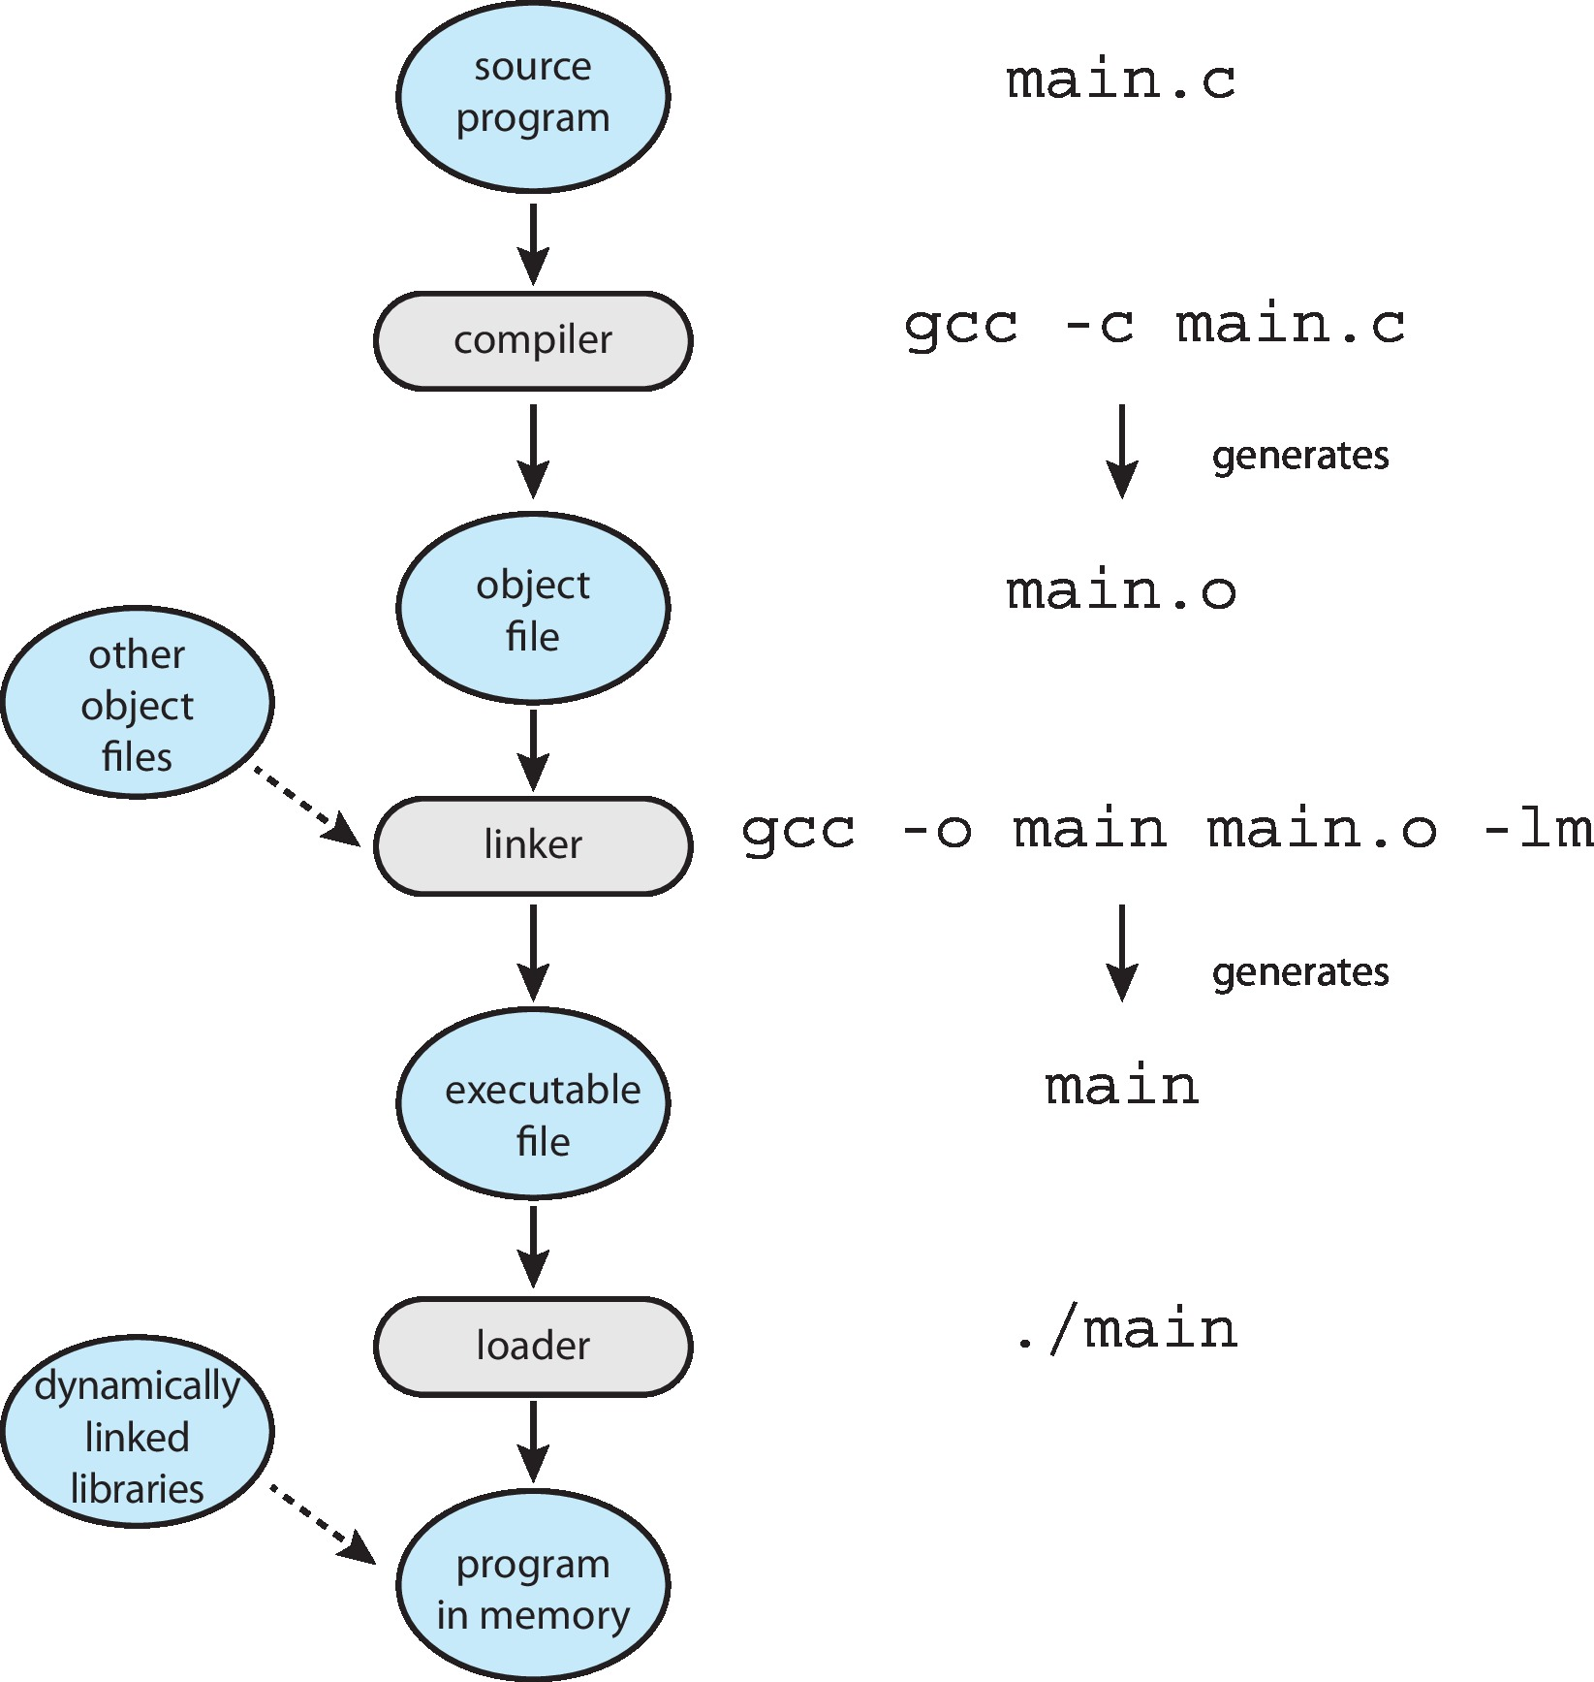
Linkers and Loaders

Slide 67
Outline
Operating System Services
User and Operating-System Interface
System Calls
System Services
Linkers and Loaders
Why Applications Are Operating-System Specific (Skip!)
Operating-System Design and Implementation
Operating-System Structure
Building and Booting an Operating System
Operating System Debugging

Slide 68
Outline
Operating System Services
User and Operating-System Interface
System Calls
System Services
Linkers and Loaders
Why Applications Are Operating-System Specific
Operating-System Design and Implementation
Operating-System Structure
Building and Booting an Operating System
Operating System Debugging

Slide 69
Operating System Design and Implementation
The problems in designing and implementing an OS
Design goal
Mechanism and policies
Implementation

Slide 70
Operating System Design and Implementation
The problems in designing and implementing an OS
Design goal
Mechanism and policies
Implementation

Slide 71
Design Goal
Start OS by defining goal
Affected by
Hardware
Type of system: traditional desktop/laptop, mobile, distributed, or real time.
User goals and System goals
User goals – OS should be convenient to use, easy to learn, reliable, safe, and fast
System goals – OS should be easy to design, implement, and maintain, as well as flexible, reliable, error-free, and efficient
There is no unique way to achieve all goals ⇨ compromises may be taken

Slide 72
Operating System Design and Implementation
The problems in designing and implementing an OS
Design goal
Mechanism and policies
Implementation

Slide 73
Mechanisms and Policies
Example:
Mechanism: priority-based systems
Policy: A program have priority over B program or vice versa.
Important principle to separate mechanism and policies
Mechanism
How to do it?
Should be insensitive to changes in policy
Policy
What will be done?
Likely to change across places or over time
Separation of policy from mechanism for flexibility

Slide 74
Operating System Design and Implementation
The problems in designing and implementing an OS
Design goal
Mechanism and policies
Implementation

Slide 75
Implementation
OS Implementation
In early days, OS were written in assembly languages
MS-DOS was written in Intel 8088 assembly language
In nowadays, OS are now written in high-level languages
Linux: 90% of Linux code was written in C
Android
The kernel is written mostly in C and some assembly language
System libraries are written in C and C++
Application frameworks are written mostly in Java

Slide 76
Implementation (Cont.) (Skip!)
Advantages of using high-level language
The code can be written faster, is more compact, and is easier to understand and debug
Improve portability: to move to some other hardware platform
See the following two slids
Disadvantages of using high-level language
Reduced speed and increased storage requirements
Solved by modern smart compiler

Slide 77
Poor Portability (Skip!)
…
add eax, 10
…
…
add R1, R0, 10
…
Need to modify
source code
x86
ARM

Slide 78
Good Portability (Skip!)
…
a = a + 1;
…
…
a = a + 1;
…
x86
ARM

Slide 79
Implementation (Cont.)
In fact, major performance improvement
NOT from using the assembly language
Because of advanced compiler techniques
Only bottleneck routine are written in assembly language
It should be better data structure and algorithms

Slide 80
Outline
Operating System Services
User and Operating-System Interface
System Calls
System Services
Linkers and Loaders
Why Applications Are Operating-System Specific
Operating-System Design and Implementation
Operating-System Structure
Building and Booting an Operating System
Operating System Debugging

Slide 81
Operating System Structure
Operating system structure
Monolithic (龐大的) structure
Layered approach
Microkernels
Modules
Hybrid systems

Slide 82
Operating System Structure
Operating system structure
Monolithic (龐大的) structure
Layered approach
Microkernels
Modules
Hybrid systems

Slide 83
Monolithic Structure
Do not have well-defined structures
Examples
MS-DOS:
Original UNIX -
Everything between the system call interface and physical hardware is the kernel.
An enormous amount of functions in one level=> monolithic (龐大的) kernel

Slide 84
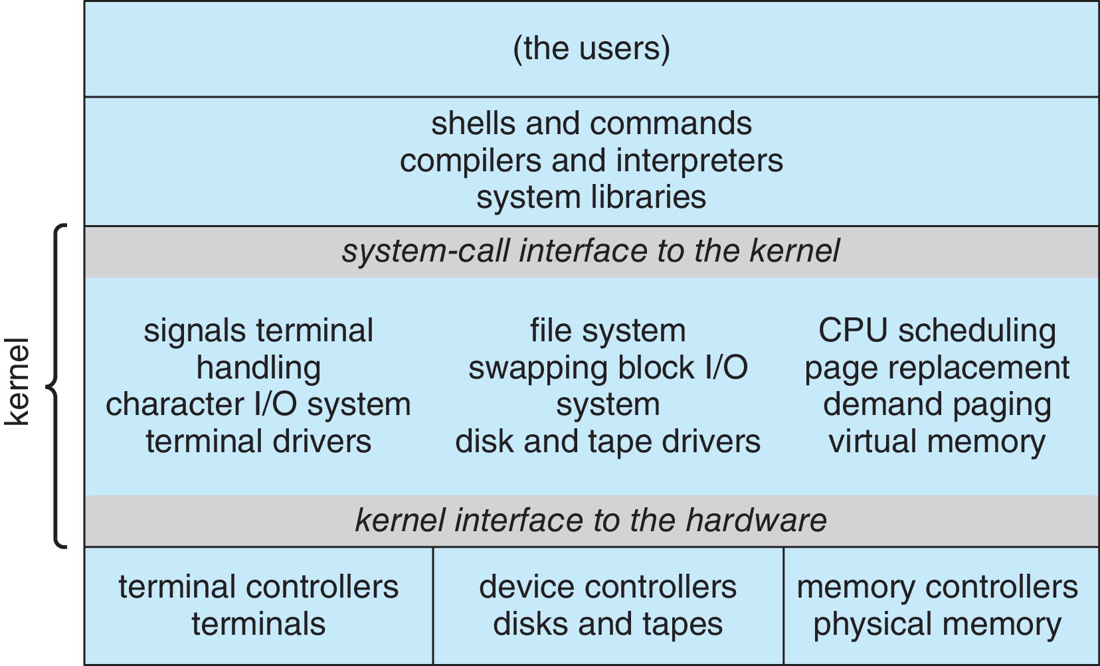
Original UNIX Architecture

Slide 85
Monolithic Structure
Monolithic Structure
Bad: Difficult to implement and extend
Good: Have a distinct performance advantage
Very little overhead in the system-call interface and communication within the kernel is fast
Discussed later
Thus, UNIX, Linux and Windows are monolithic kernels

Slide 86
Operating System Structure
Operating system structure
Monolithic structure
Layered approach
Microkernels
Modules
Hybrid systems

Slide 87
Layered Approach
OS is divided into a number of layers
Layer approach: each layer uses functions and services of only lower-level layers
Advantages:
Simplicity of construction and debugging
Starts from the lowest layer
Information hiding
Do not have to know the details of the other layers

Slide 88
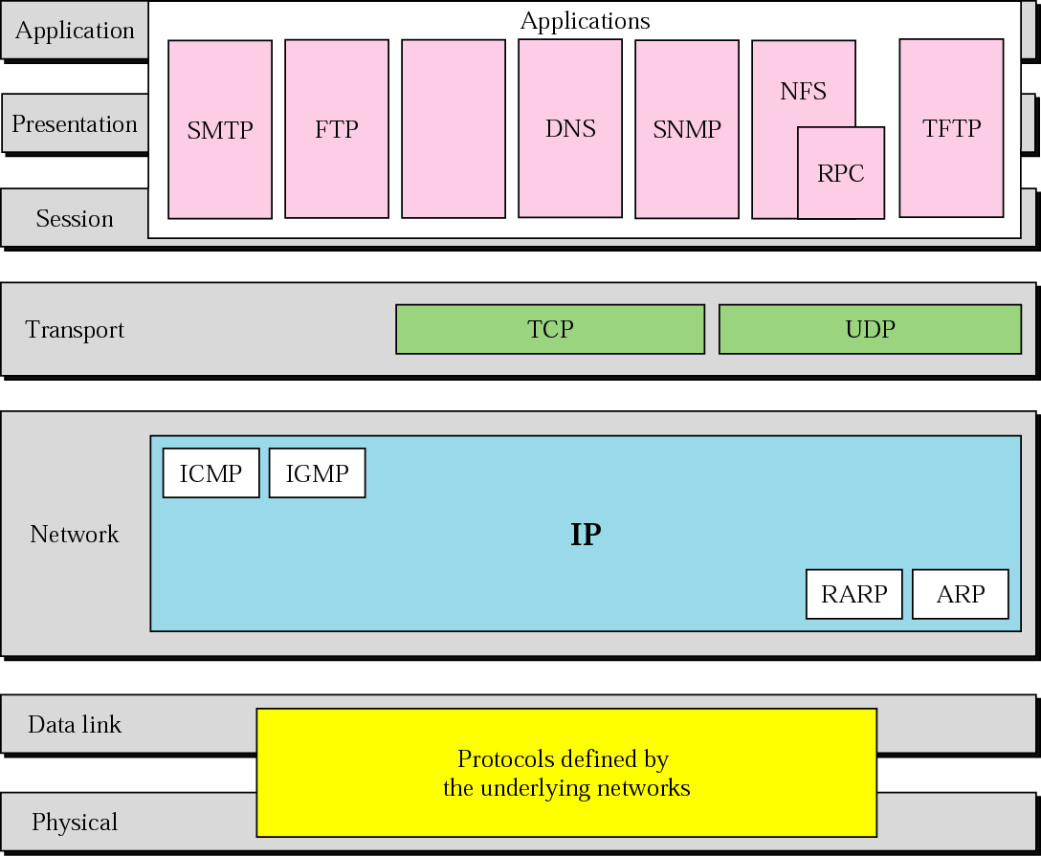
Figure 2-15
TCP/IP and OSI Model
The McGraw-Hill Companies, Inc., 2000

Slide 89
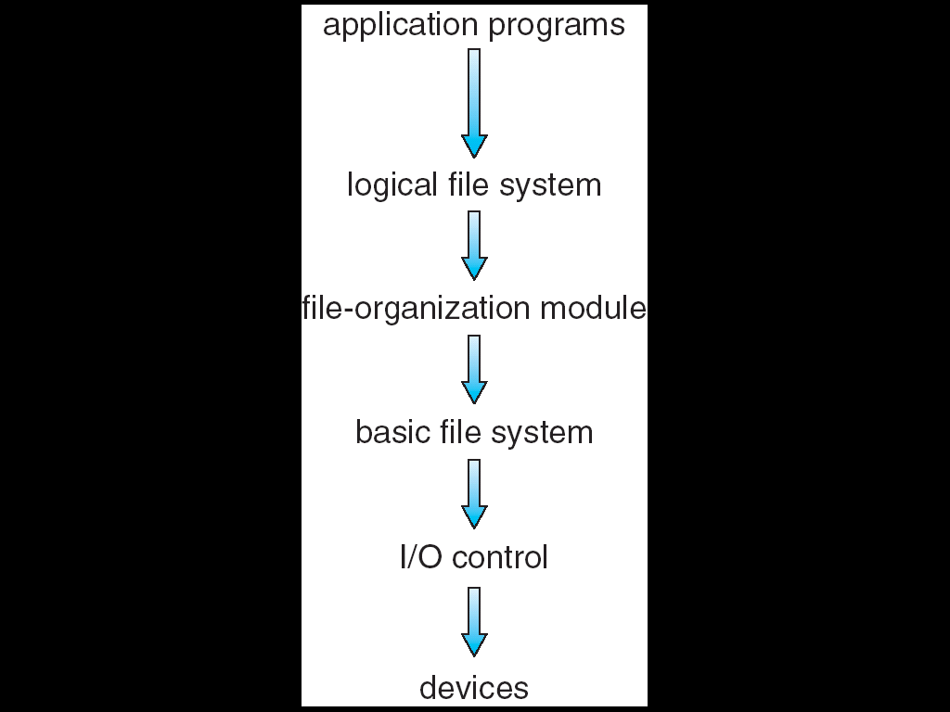
Layered File System: File System Organized into Layers

Slide 90
Layered Approach (Cont.)
Difficulties
Hard to determine the number of layers
Hard to define functionality of each layer
Less efficient
A service may involve multiple layers
But each layer adds overhead
Trend: fewer layers with more functionality

Slide 91
Operating System Structure
Operating system structure
Monolithic structure
Layered approach
Microkernel
Modules
Hybrid systems

Slide 92
Microkernel
Motivation: due to UNIX became large and difficult to manage
Idea: moves as much from the kernel into user space
A smaller kernel
Mach: the first microkernel by CMU
What a microkernel should provide ?
Typically, minimal process and memory management, and a communication facility
Communication facility
Provide communication between the client program and the various services (called servers)
Provided by message passing

Slide 93
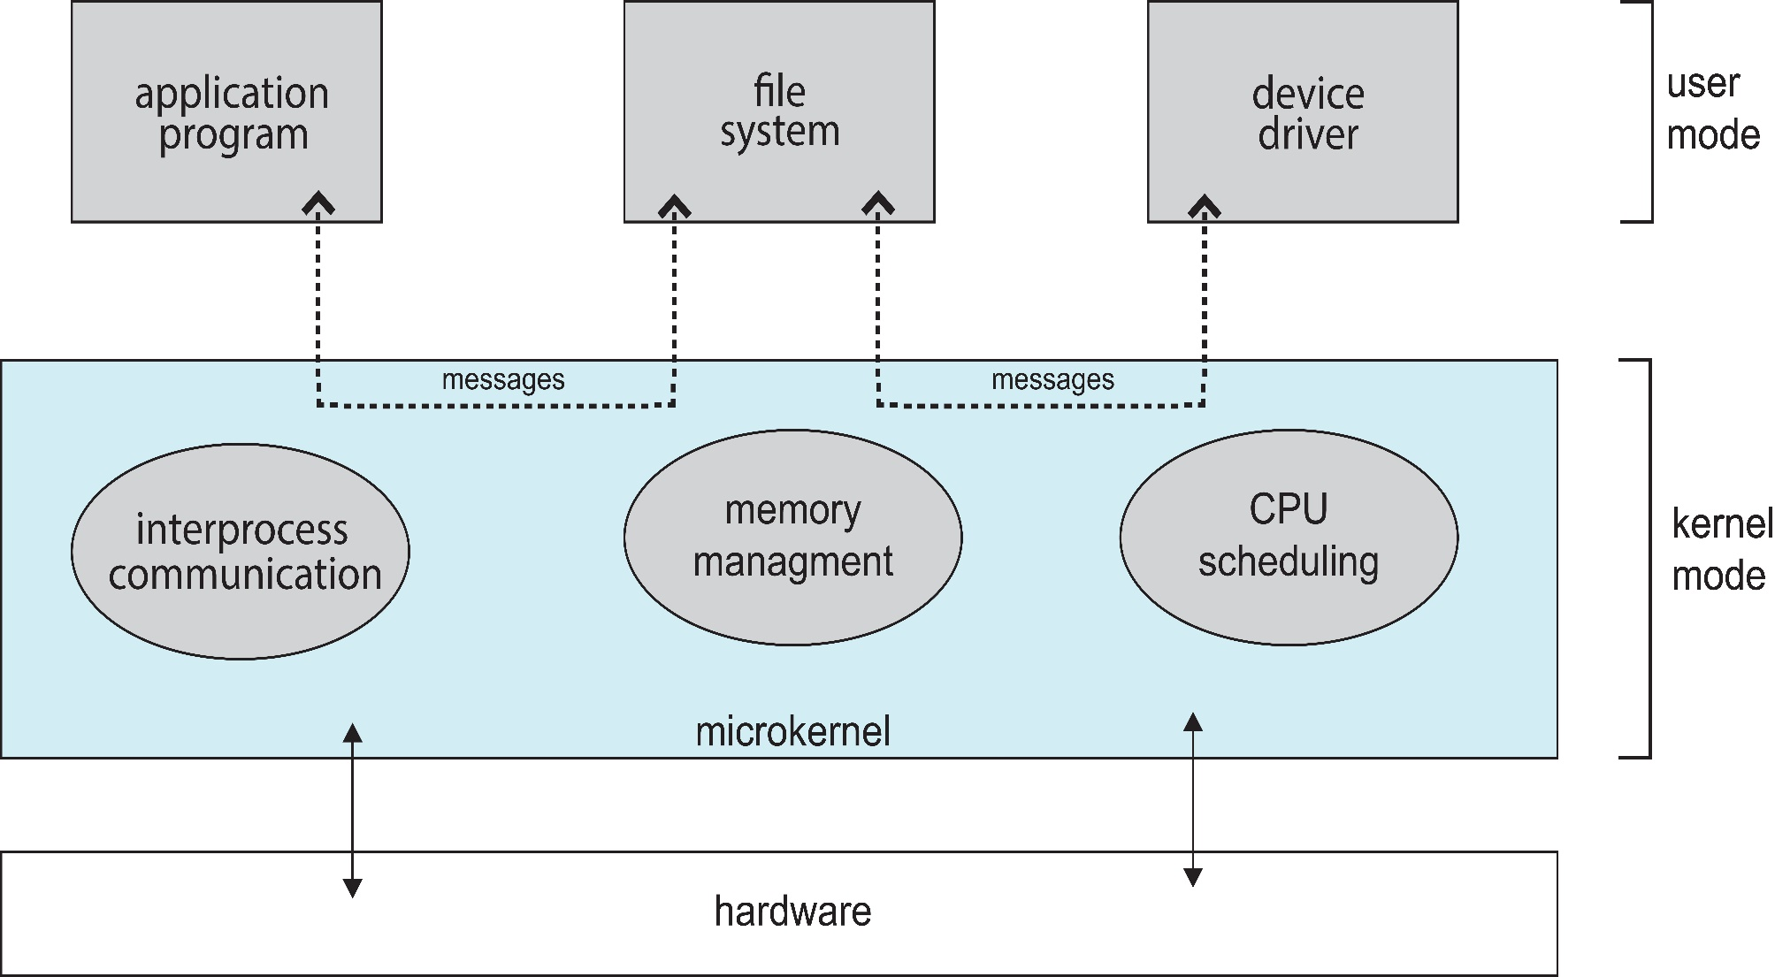
Microkernel System Structure

Slide 94
Microkernel (Cont.)
Advantages:
Easier to extend the OS
By adding new services and do not require kernel modification
Easier to port the OS to new architectures
The kernel is small and the changes tend to be fewer
More reliable and more secure
Most services are running as user processes
If a service failed, the rest of the OS remains untouched
Disadvantages:
Performance overhead by message passing between services
Window NT: microkernel, Windows XP: a monolithic kernel

Slide 95
為什麼Message Passing會造成很大的overhead呢？
第三章我們會介紹

Slide 96
Operating System Structure
Operating system structure
Monolithic structure
Layered approach
Microkernels
Modules
Hybrid systems

Slide 97
Modules
Best current methodology in OS design
An OS consists of
A core kernel
A set of loadable kernel modules (LKMs) that can dynamically loadable at run time
Resemble a layered system
But more flexible
A module can call any other module
Resemble the microkernel approach
Primary core kernel has only core functions
But more efficient
Kernel module communications is function calls, not by message passing

Slide 98
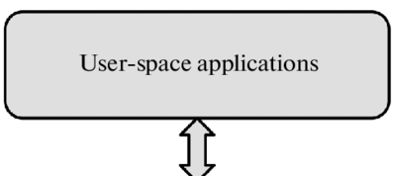
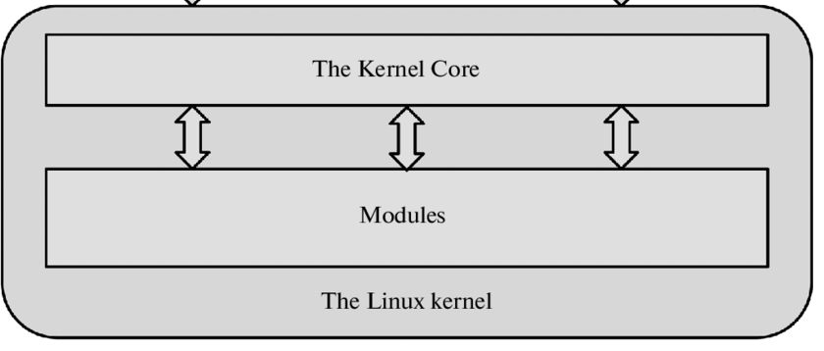
Modules
https://www.researchgate.net/figure/Interaction-of-Linux-kernel-modules-with-their-environment_fig1_299373758

Slide 99
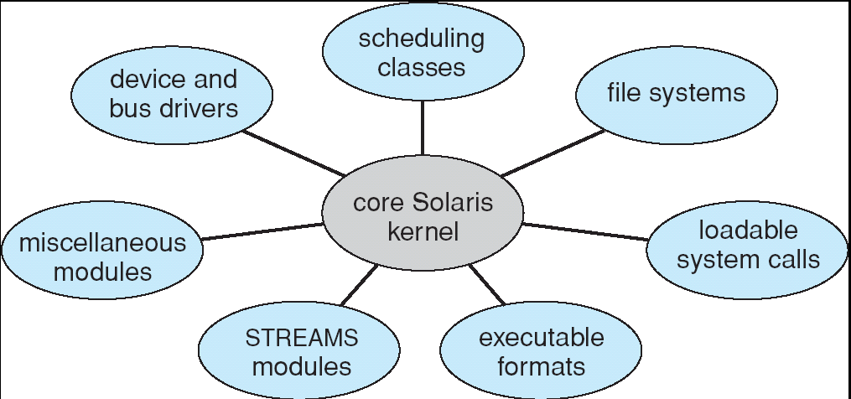
Example: Solaris Modular Approach
Solaris is organized around a core kernel with seven types of loadable kernel modules

Slide 100
Operating System Structure
Operating system structure
Monolithic structure
Layered approach
Microkernels
Modules
Hybrid systems

Slide 101
Hybrid Systems
Modern operating systems do not adopt a single structure
Hybrid systems combine multiple structures
Linux is monolithic,
+ modules for dynamic loading of functionality
Windows is mostly monolithic
+ personalities (user-level services) (microkernel)
+ modular for dynamic loading of functionality

Slide 102
Outline
Operating System Services
User and Operating-System Interface
System Calls
System Services
Linkers and Loaders
Why Applications Are Operating-System Specific
Operating-System Design and Implementation
Operating-System Structure
Building and Booting an Operating System (Skip!)
Operating System Debugging

Slide 103
Outline
Operating System Services
User and Operating-System Interface
System Calls
System Services
Linkers and Loaders
Why Applications Are Operating-System Specific
Operating-System Design and Implementation
Operating-System Structure
Building and Booting an Operating System
Operating System Debugging (Skip!)

